Slide 1
Key User Training –
JAGGAER Direct SRM (Supplier Side)
Prepared by BearingPoint GmbH
Prepared for ebm-papst Mulfingen GmbH & Co. KG

Slide 2
Agenda
Supplier Initial Registration
Registration Profile (Small Profile)(Basic Data)​
Qualification Profile (Big Profile - Detailed Data)​
Actions Pure
Documents Pure

Slide 3
Training Objectives
JAGGAER Direct SRM
Clear understanding of SRM process​
Step-by-step system navigation​
Role clarity (End User vs Key User)​
Efficient supplier onboarding execution​

Slide 4
End-to-End Process Overview
1. Supplier Request Ticket​
2. Registration Profile (Small Profile)(Basic Data)​
3. Big Profile (Detailed Data)​
4. Actions Pure
5. Documents Pure

Slide 5
Supplier Initial Registration

Slide 6
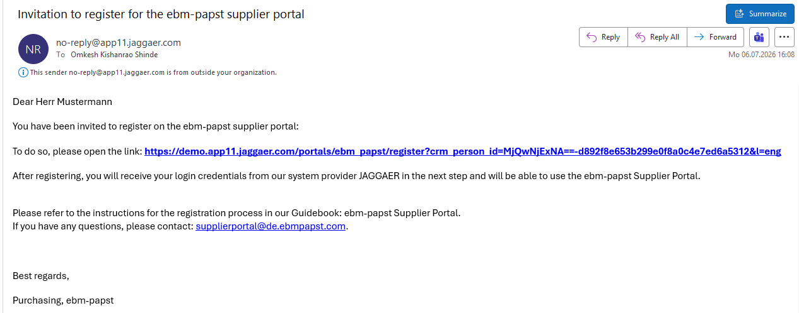
Supplier Initial Registration (On Supplier side)
Step 1: Email Notification for Supplier
When the GTS team approves the supplier, the supplier record is then created in JAGGAER, and an email notification is automatically sent to the supplier for registration. Supplier can click the link to proceed with registration
Important: Please always use a different web browser when switching between JAGGAER buyer and JAGGAER supplier portal. All three most frequent web browsers (Chrome, Edge, Firefox) are supported.

Slide 7
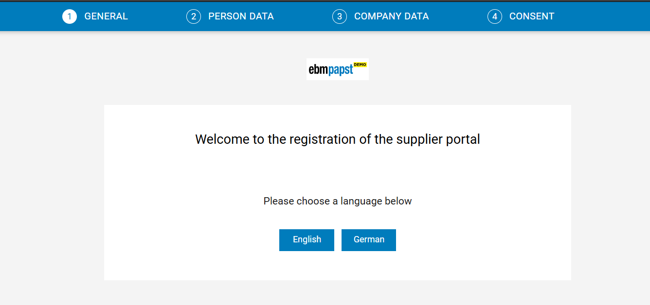
Supplier Initial Registration (On Supplier side)
Step 2: Supplier Initial Registration - General
The supplier clicks on the link in the email and is redirected to the General Registration page, where two language options are available:
a. English (English will be used for the subsequent process)
b. German.

Slide 8
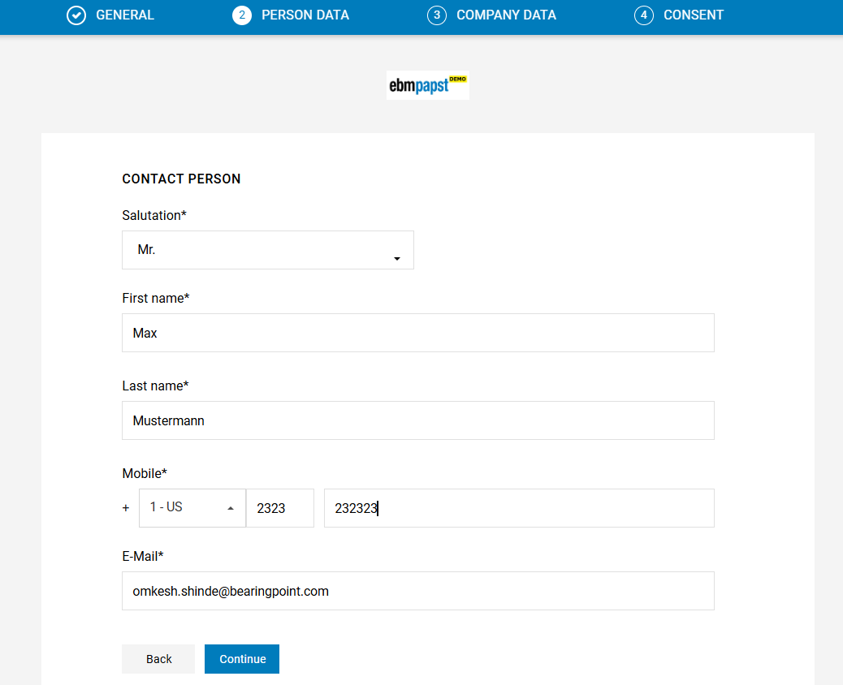
Supplier Initial Registration (On Supplier side)
Step 3: Supplier Initial Registration – Person Data
Now the user will land on Person data page, fill all required Person data. (Please note that some information is already prefilled by system as it is filled by buyer while creating the contact).

Slide 9
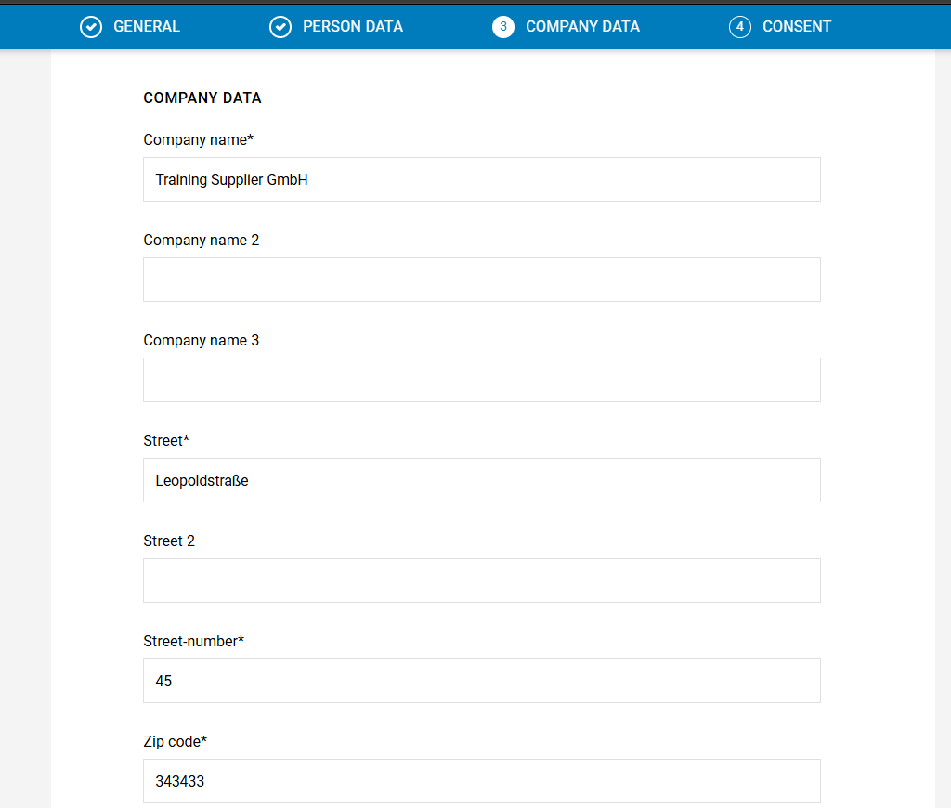
Supplier Initial Registration (On Supplier side)
Step 4: Supplier Initial Registration- Company Data
The supplier is redirected to the Company Data page. Please complete all fields to ensure that the information entered can be verified and correctly mapped into the JAGGAER buyer portal. After completing all required fields, click ‘Continue’. Please note: All fields marked with * are mandatory and must be completed.

Slide 10
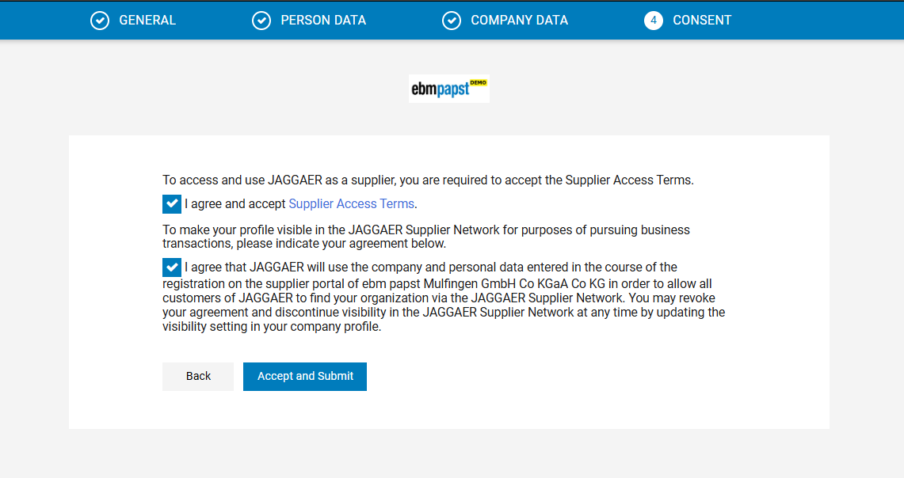
Supplier Initial Registration (On Supplier side)
Step 5: Supplier Initial Registration - Consent
The supplier is redirected to the Consent page. To proceed, the supplier must select the checkbox to accept and submit the following documents: Supplier Access Terms provided by JAGGAER for ebm-papst

Slide 11

Registration Profile (Small Profile)

Slide 12
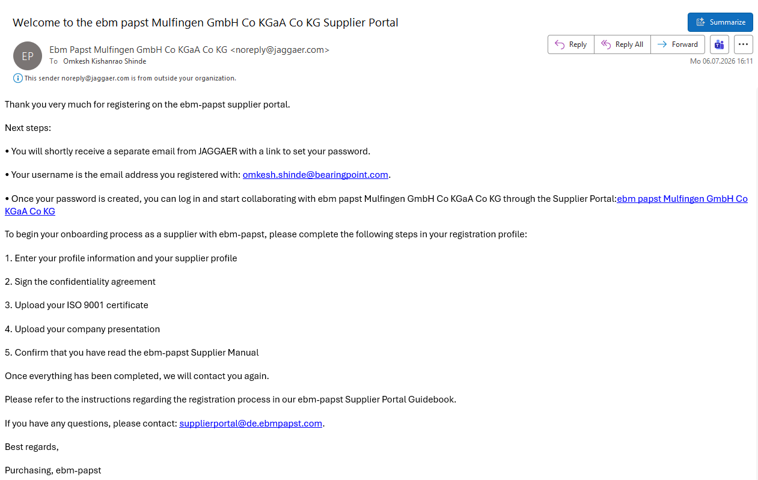
Supplier Registration - Registration Profile
Step 1: Supplier Email Notification & Reset Initial Password
The supplier will receive initial login credentials via email notification instructing what to do next. If you don´t have supplier account with ebm-papst, you will receive another email to set up your password.

Slide 13
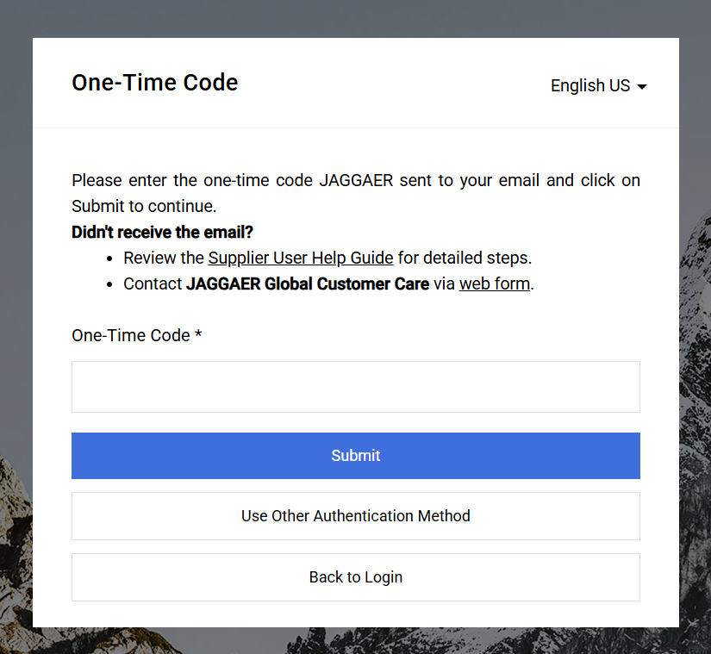
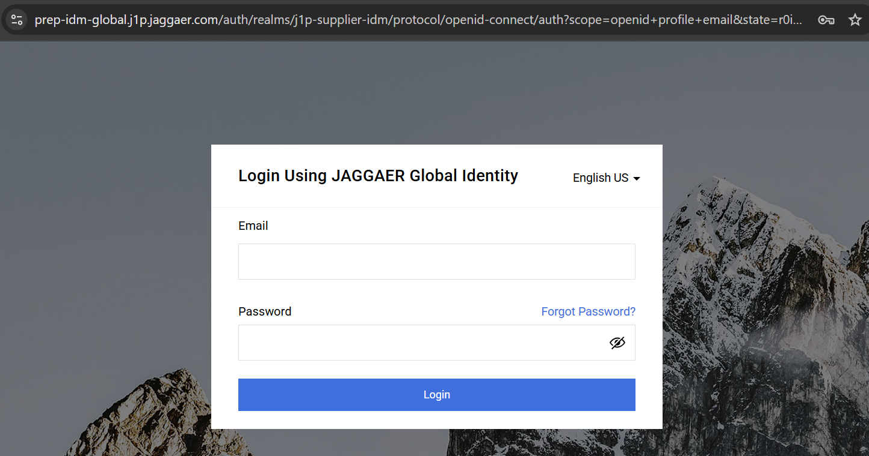
Supplier Registration – Registration Profile
Step 2: Log In to Supplier Portal
Once you reset the password for the first time then use following link to log in as a supplier and complete the registration: https://demo.app11.jaggaer.com/portals/ebm_papst (For DEMO) and https://app11.jaggaer.com/portals/ebm_papst (For PROD)
Then insert One-Time Authentication code which you received via another email.

Slide 14
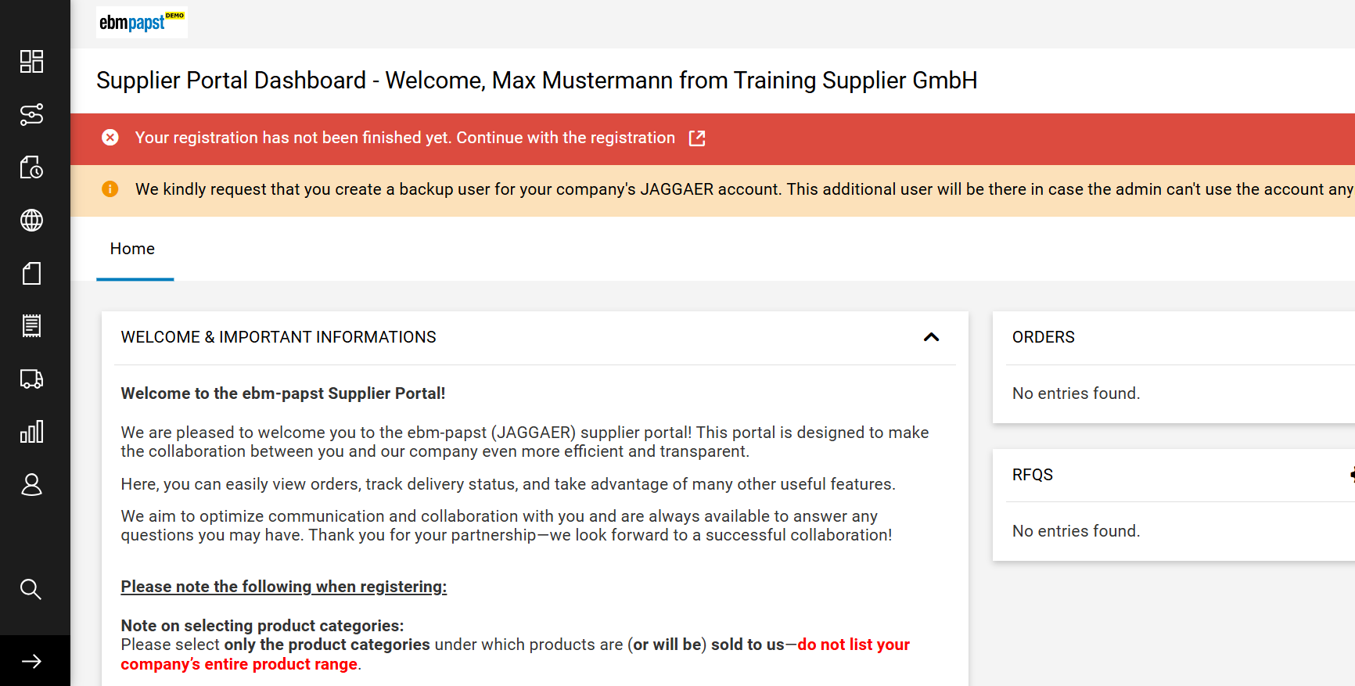
Supplier Registration – Registration Profile
Step 3: Navigate to Registration Profile
Now supplier has successfully logged in to the portal, but the supplier registration is not completed. To complete registration, click on small arrow as shown in following screenshot.
Important Information for suppliers

Slide 15
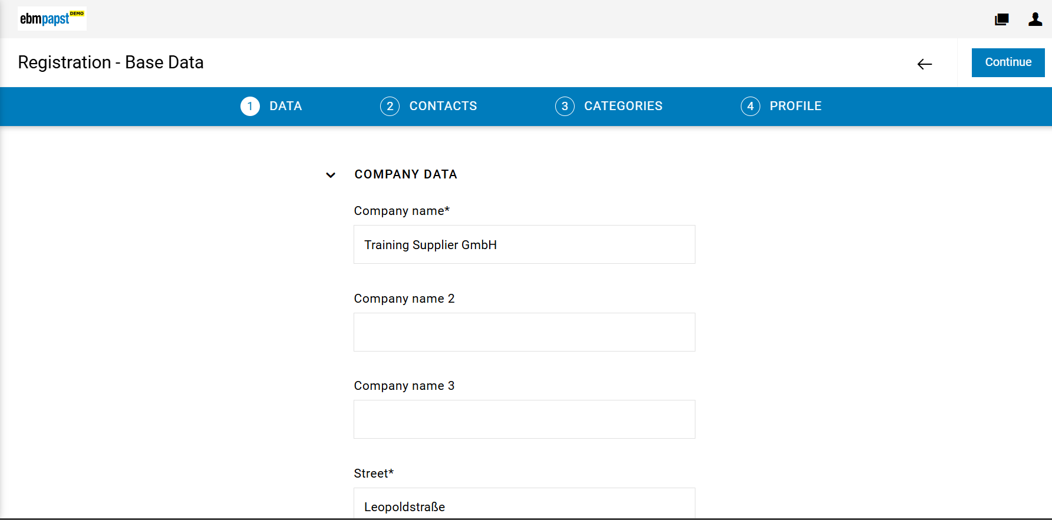
Supplier Registration – Registration Profile
Step 4: Registration Base data
Review the company details within the Data tab and then click continue.
Review the data

Slide 16
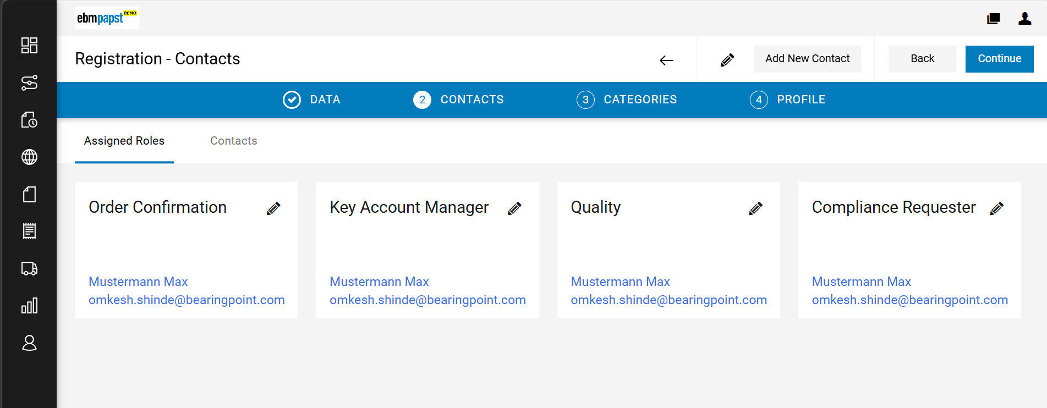
Supplier Registration – Registration Profile
Step 5: Maintain Contact and Assign responsibility
The Contacts tab displays the supplier contact (your email) with responsibilities such as Order Confirmation, Key Account Manager, and Quality & Compliance requester. More contacts can be added or updated if needed by clicking on "Add New Contact". Click ‘Continue’.

Slide 17
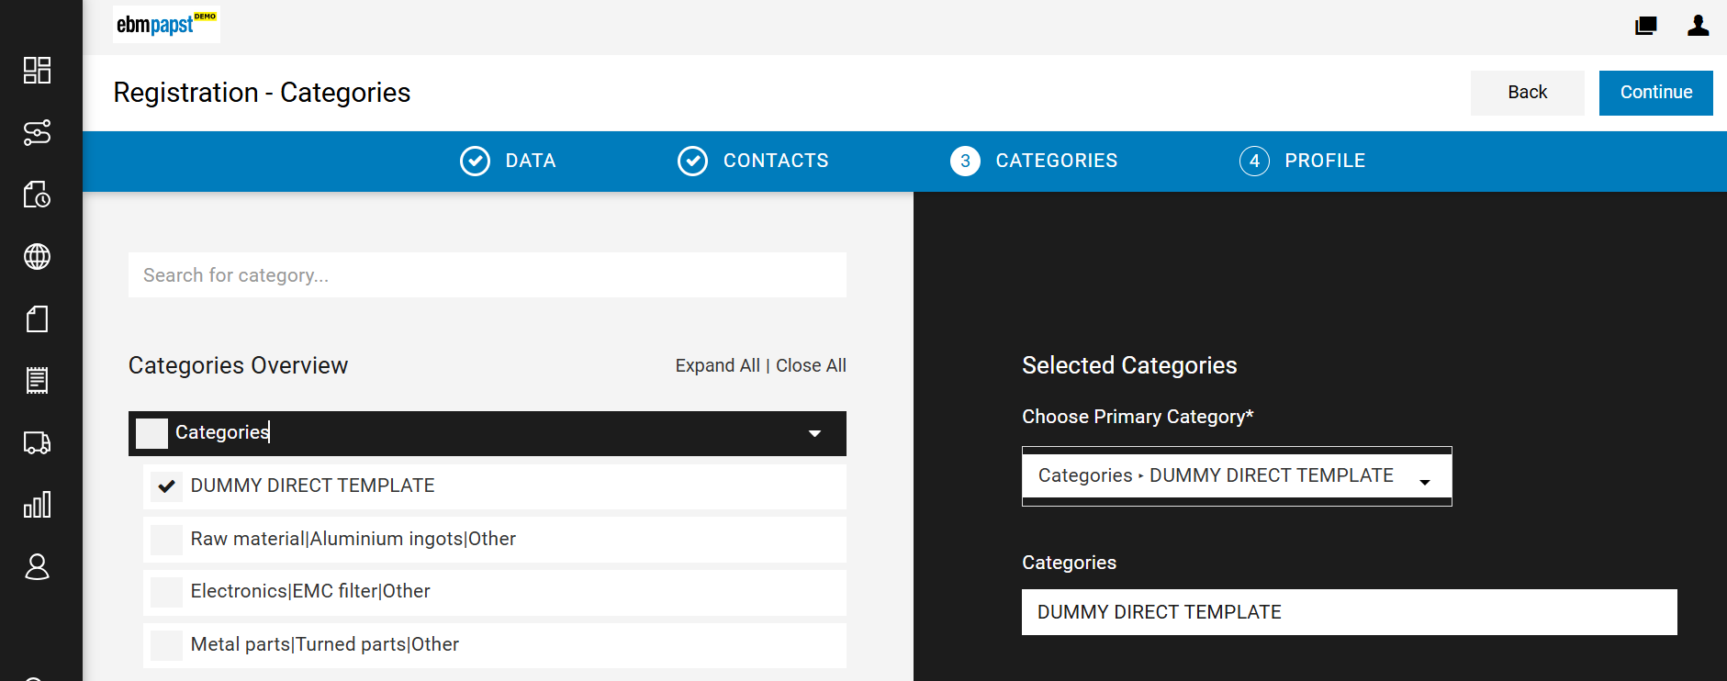
Supplier Registration – Registration Profile
Step 6: Select Category
Primary Category must be selected to complete the registration and several secondary category can be selected if needed. In the Assign Category step, if a supplier selects a category without an assigned Lead Buyer, the request is routed to the Clearing Group for approval. The assigned user can approve, reject, or forward the request.
In this case, the category is preselected by the buyer; the supplier may change it if needed, but for this training, it will remain unchanged. Click ‘Continue’.

Slide 18
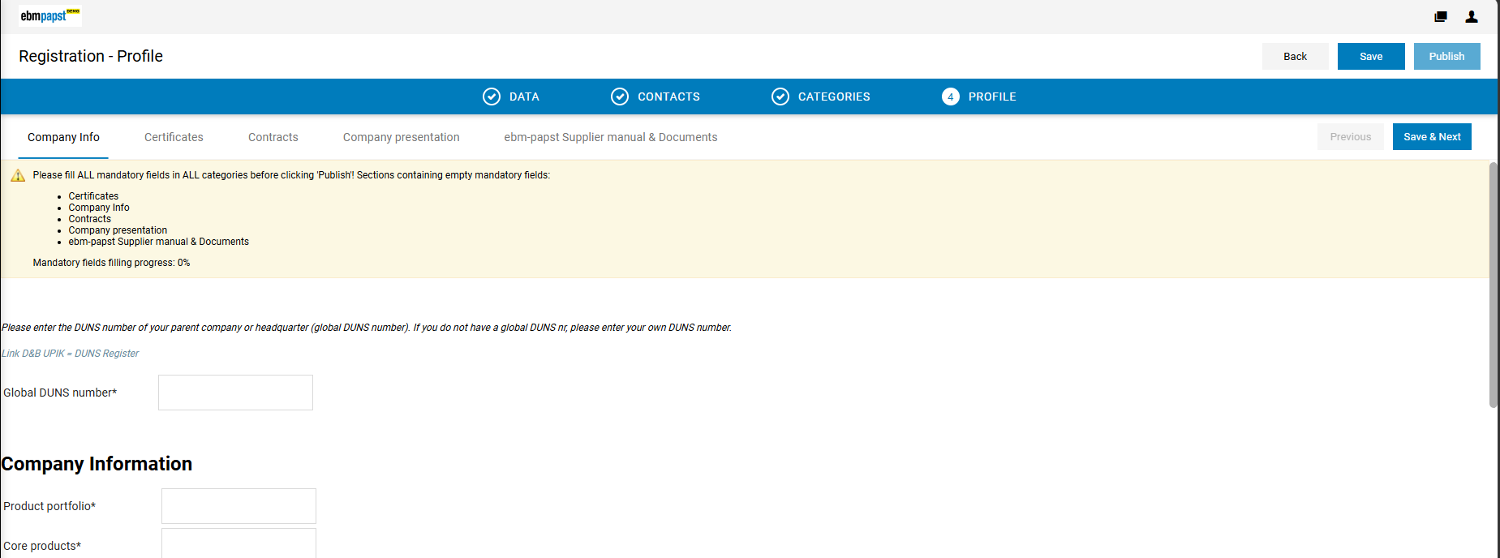
Supplier Registration - Registration Profile
Step 7: Complete Registration Profile
Fill supplier profile questionnaire from Company Info, Certificates, Contracts, Company presentation, ebm-papst Supplier manual and Documents then Save & Next.
The yellow box shows the progress of mandatory field completion.

Slide 19
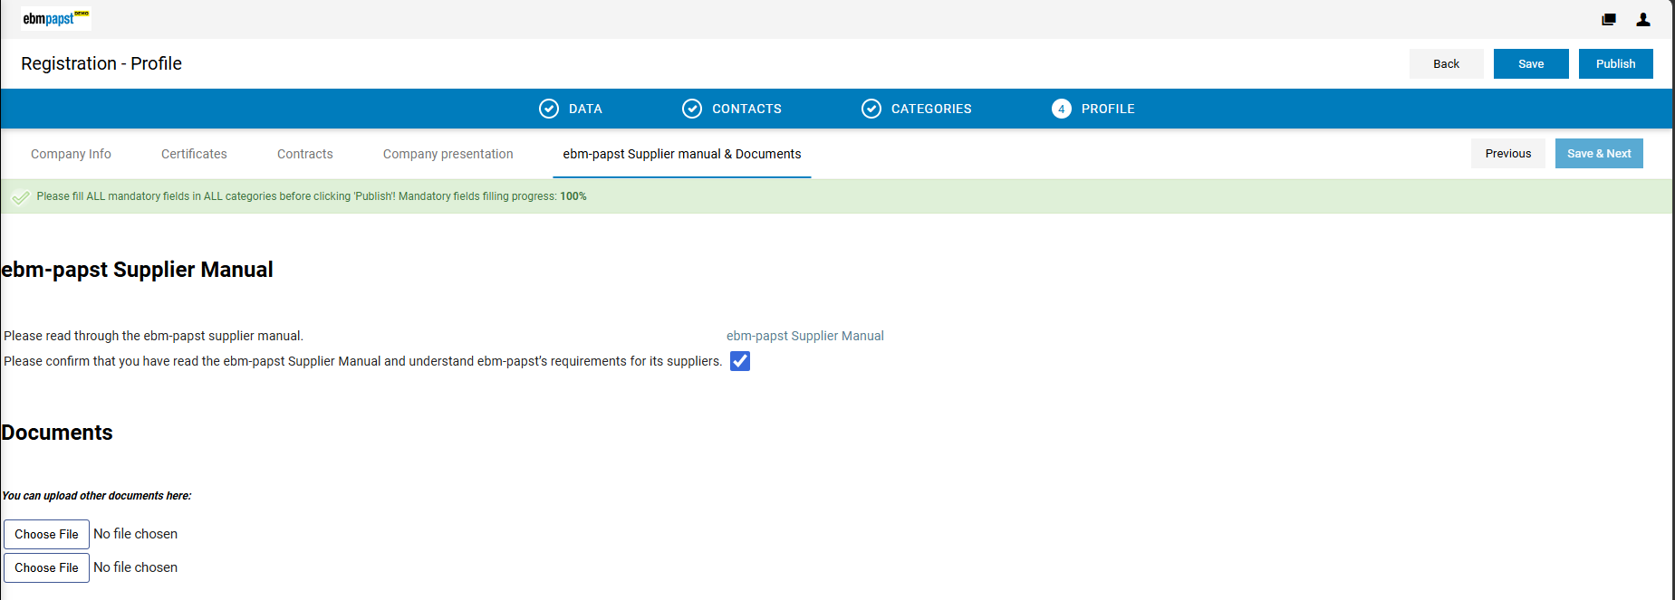
Supplier Registration – Registration Profile
Step 8: Publish Registration Profile
After filling all mandatory fields from Supplier Questionnaire click on Publish

Slide 20
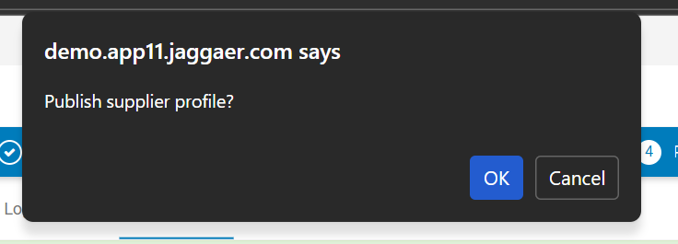
Supplier Registration – Registration Profile
Step 8: Publish Registration Profile
Once filling all mandatory fields from Supplier Questionnaire click on Publish.
After publishing Supplier needs to wait till Buyer approves the profile, and once buyer approves it supplier will receive the email notification.

Slide 21
Qualification Profile - Big Profile
(On Supplier Side)

Slide 22
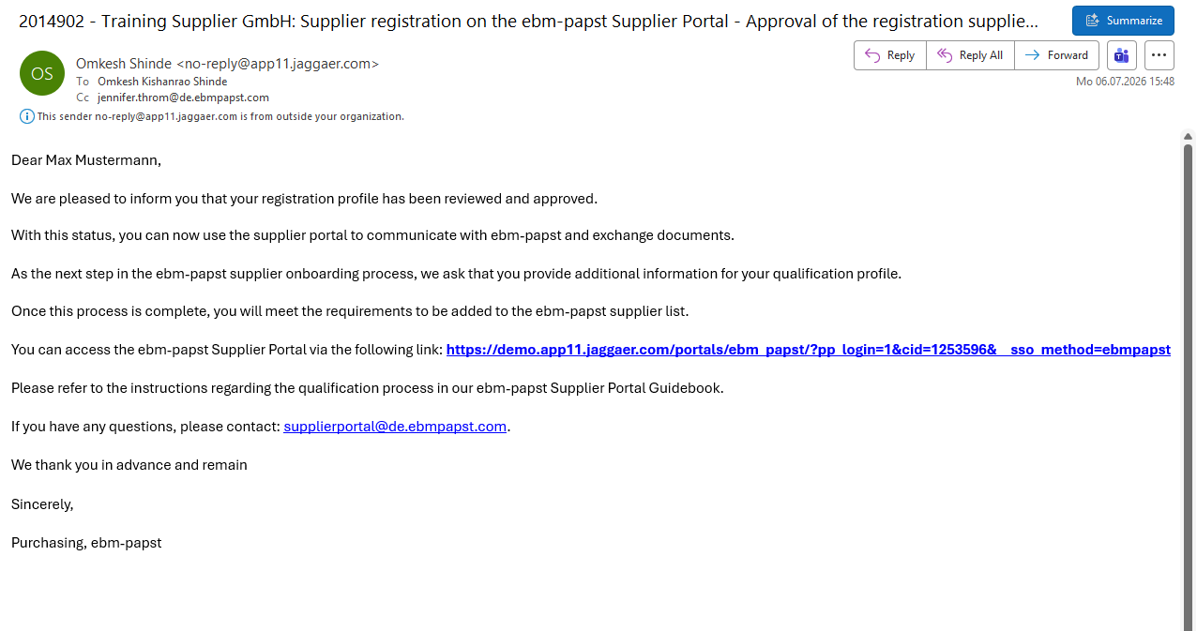
Supplier Registration – Qualification Profile
Step 1: Email Notification to Supplier
Once the Buyer approves Registration Profile (small Profile), The supplier receives a confirmation of successful registration via email and is requested to complete the big profile to finalize the registration process. The supplier can then log in to the supplier portal using the link below.

Slide 23
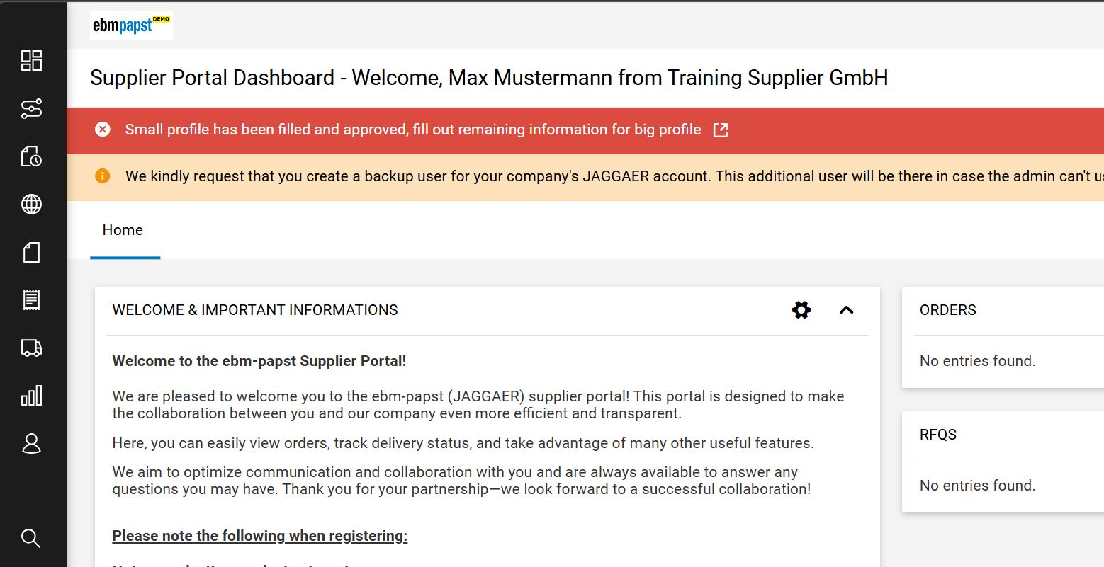
Supplier Registration – Qualification Profile
Step 2: Navigate to Qualification Profile
Now supplier has successfully logged into the portal, but still supplier registration is not completed. To complete registration, click on the small arrow as shown in following screenshot

Slide 24
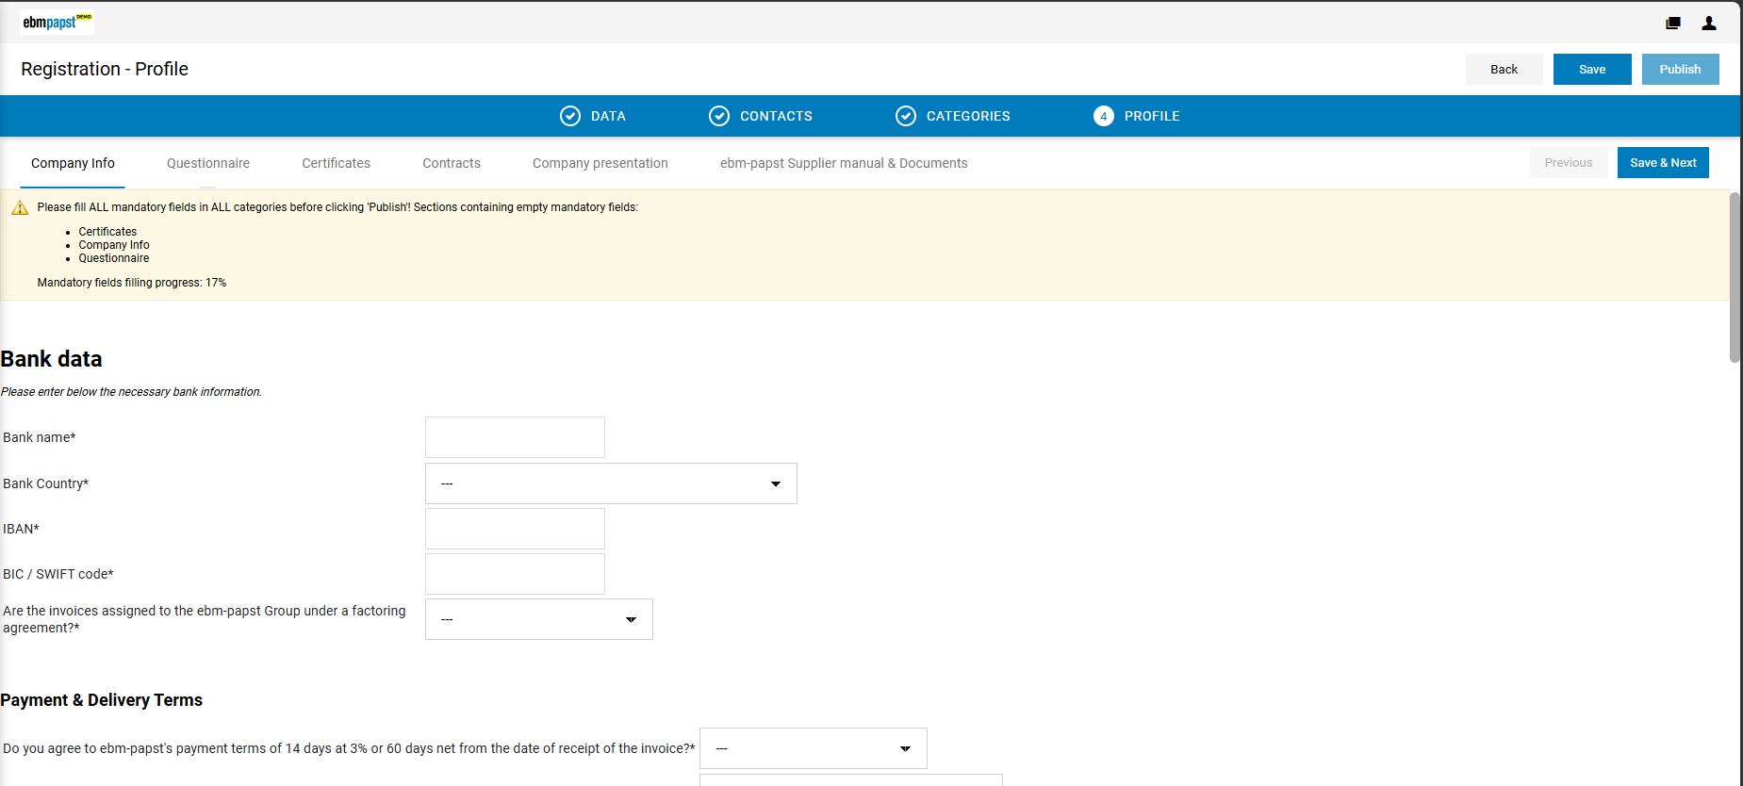
Supplier Registration – Qualification Profile
Step 3: Complete Qualification Profile
Fill supplier profile questionnaire from Company Info, Business Agreement, Certificates, Contracts, Documents, Logistics, Environment and then Save & Next.
The yellow box shows the progress of mandatory field completion.

Slide 25
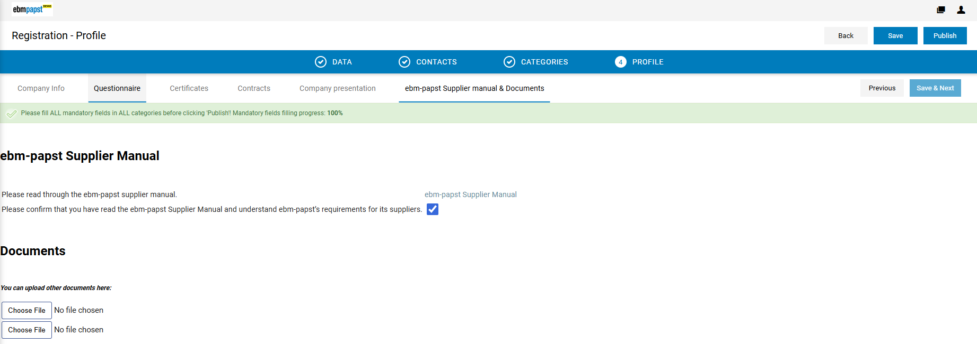
Supplier Registration – Qualification Profile
Step 4: Publish Qualification Profile
After filling all mandatory fields from Supplier Questionnaire click on Publish
Once the Big Profile is published supplier needs to wait till Buyer accepts it.

Slide 26
Supplier Registration – Qualification Profile
Step 5: Publish Registration Profile
Once filling all mandatory fields from Supplier Questionnaire click on Publish.
After publishing Supplier needs to wait till Buyer approves the profile, and once buyer approves it supplier will receive the email notification.

Slide 27
ACTIONs Module​

Slide 28
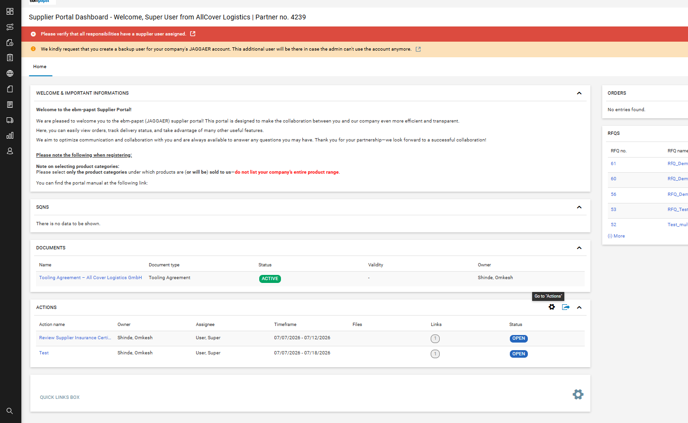
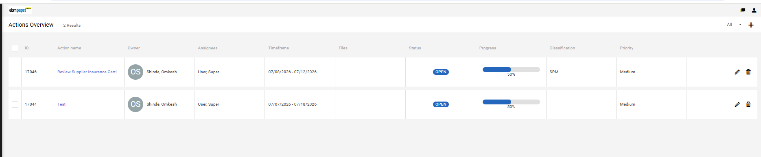
Actions
Navigate to Actions Overview
Once the action is created, the supplier will receive an email notification. The supplier can then log in to the Supplier Portal. From the Supplier Portal dashboard, the supplier can view and update the action according to their assigned permissions. This enables transparent collaboration between the supplier and the buyer.

Slide 29
Document Pure

Slide 30
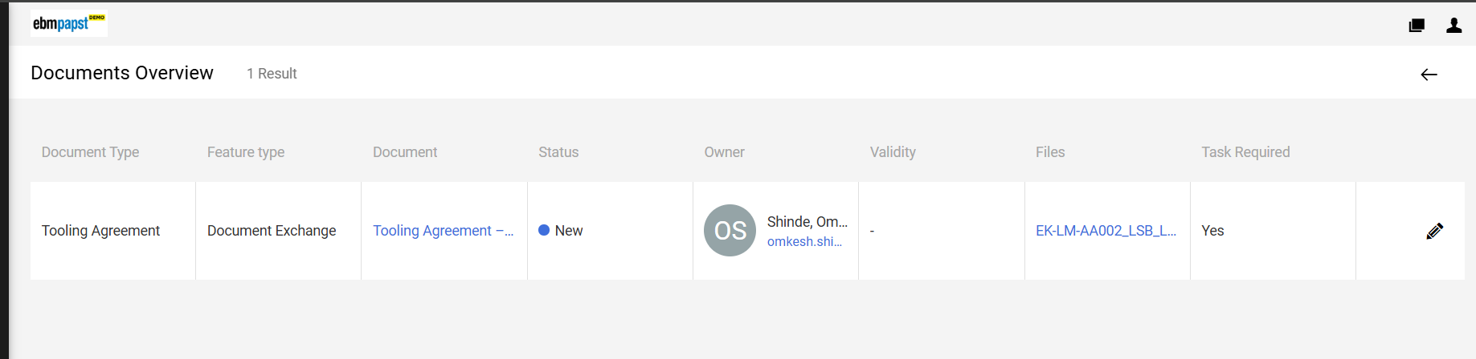
Documents
Supplier Portal view
Once the action is created, the supplier will receive an email notification. The supplier can then log in to the Supplier Portal. From the Supplier Portal dashboard, the supplier can view and edit the documents in line with the functionalities described earlier and according to their permissions. This enables transparent collaboration.

Slide 31
Enjoy Supplier Onboarding with JAGGAER DIRECT SRM!

